Slide 1

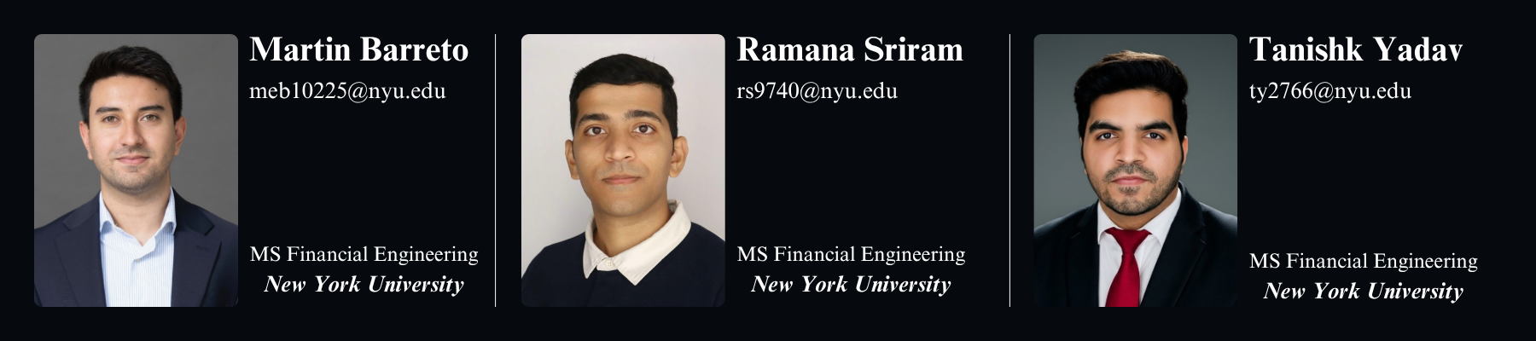

Ticker : AVGO US Equity
Spot Price : $399
A NASDAQ Listed Firm
Sector: Semiconductor & Software
BUY
Target : $475 +19% upside

Slide 2
Investment Thesis At-a-Glance
AI thesis is real & multiple is defensible
6-customer XPU franchise;
22x forward P/E
Customer concentration is a real risk but rapidly diversifying
Google falls from 45% to 33% by FY27
Margins are the
upside surprise
Gross margin guided flat 77% through FY27
Competitive moat wider than market gives credit
18-month design lead over COT (Zebrafish)
Six methods triangulate to $475
Modestly above Street median ($460)
1

Slide 3
Business Overview
Semiconductor Solutions
Infrastructure Software
Scale: $40.0B (62% of FY25 Rev)
Products: Custom AI accelerators (XPUs), networking silicon, wireless, broadband, storage.
AI Shift: Cyclical legacy business transformed by $24B annualized AI run-rate (growing 100%+ YoY).
Scale: $23.9B (38% of FY25 Rev)
Products: VMware Cloud Foundation, Symantec, CA mainframe.
Economics: 92%+ gross margin subscription model.
The Broadcom Playbook (Hock Tan, CEO since 2006):
Serial M&A → Strip overhead → Re-price to top enterprises. (5Y Rev CAGR: 23.5%)
2

Slide 4
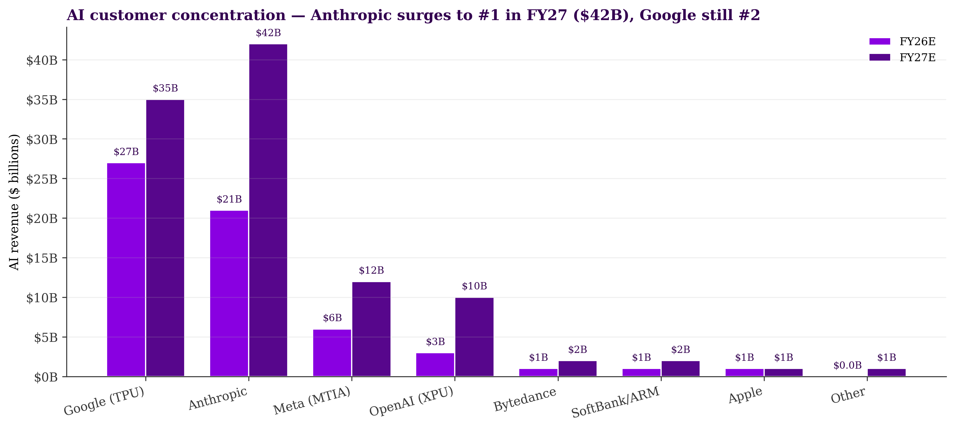






The AI Customer Story
Six Committed XPU Customers:
Google (TPU): The anchor program ($27B → $35B in FY27).
Anthropic: Explodes to $42B in FY27 via Google Cloud (largest contributor).
Meta (MTIA): Extended through 2029 (multi-GW).
OpenAI: 10-GW co-design deal ($3B → $10B).
Management’s FY27 “$100B+” AI revenue guide is fully supported by the XPU portfolio effect
3

Slide 5
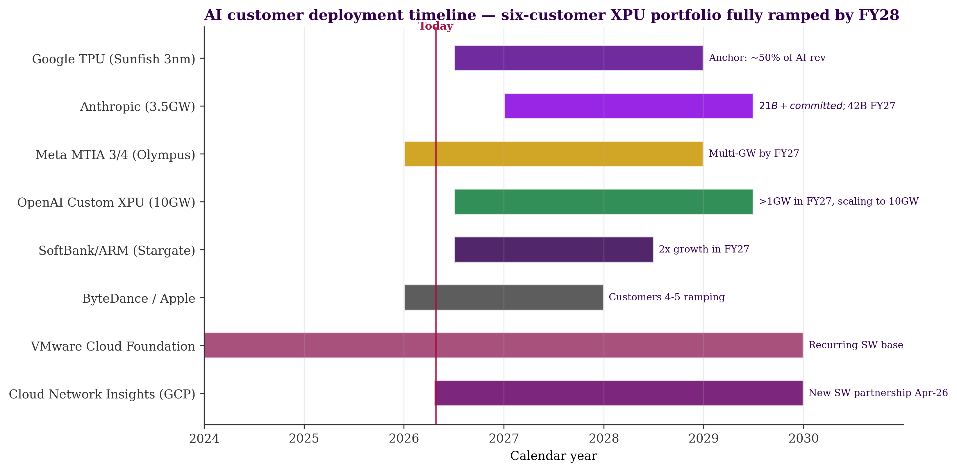
Recent Strategic Catalysts
Oct 2025: OpenAI 10-GW custom XPU partnership
Apr 2026: Anthropic 3.5-GW 3-way deal via Google Cloud.
Apr 2026: Meta MTIA extended through 2029
4

Slide 6
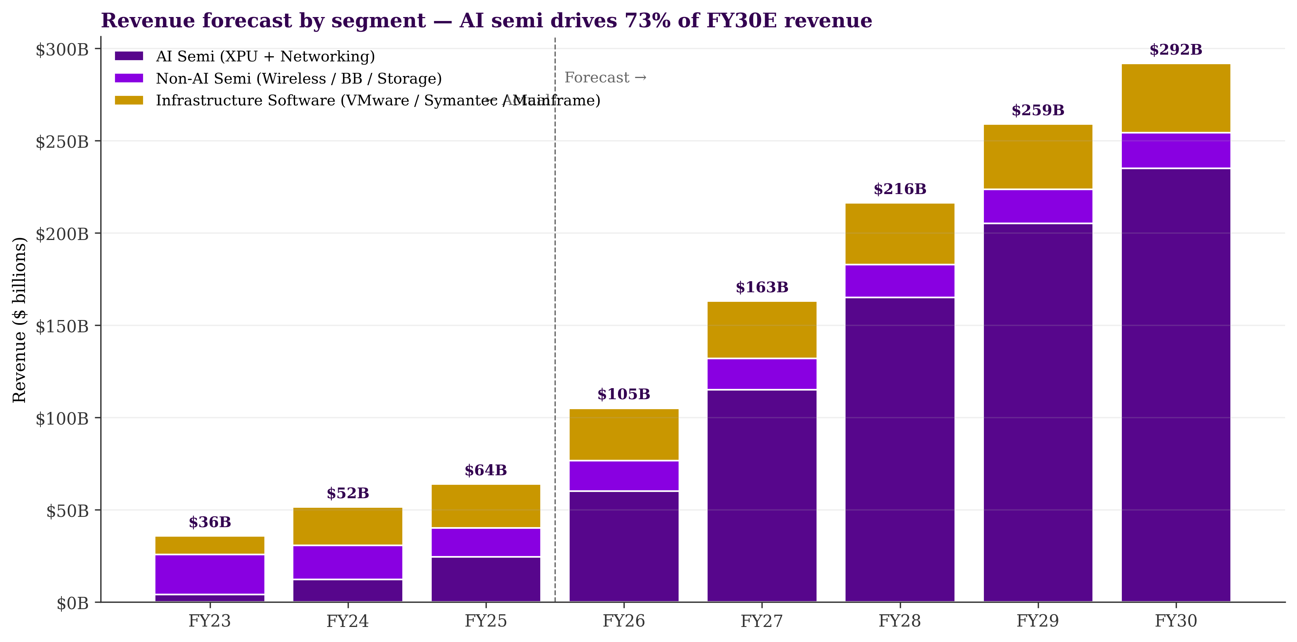
Financial Trajectory
Top-Line Growth (41% AI CAGR)
FY26E: $105B (+64% YoY)
FY27E: $163B
FY30E: $ 292B
Margin Expansion
EBITDA expands from 67.7% today to 72% by Fy2030
Reversal of rack-scale margin warning was the largest Q1 positive surprise.
5

Slide 7
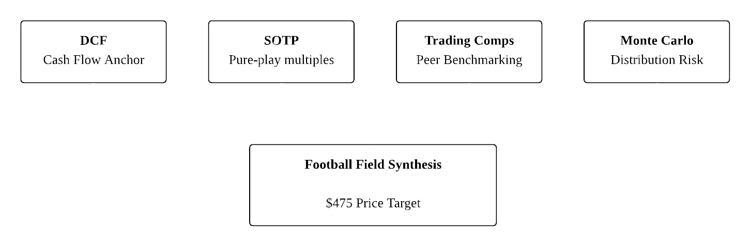
Valuation Framework Overview
6

Slide 8
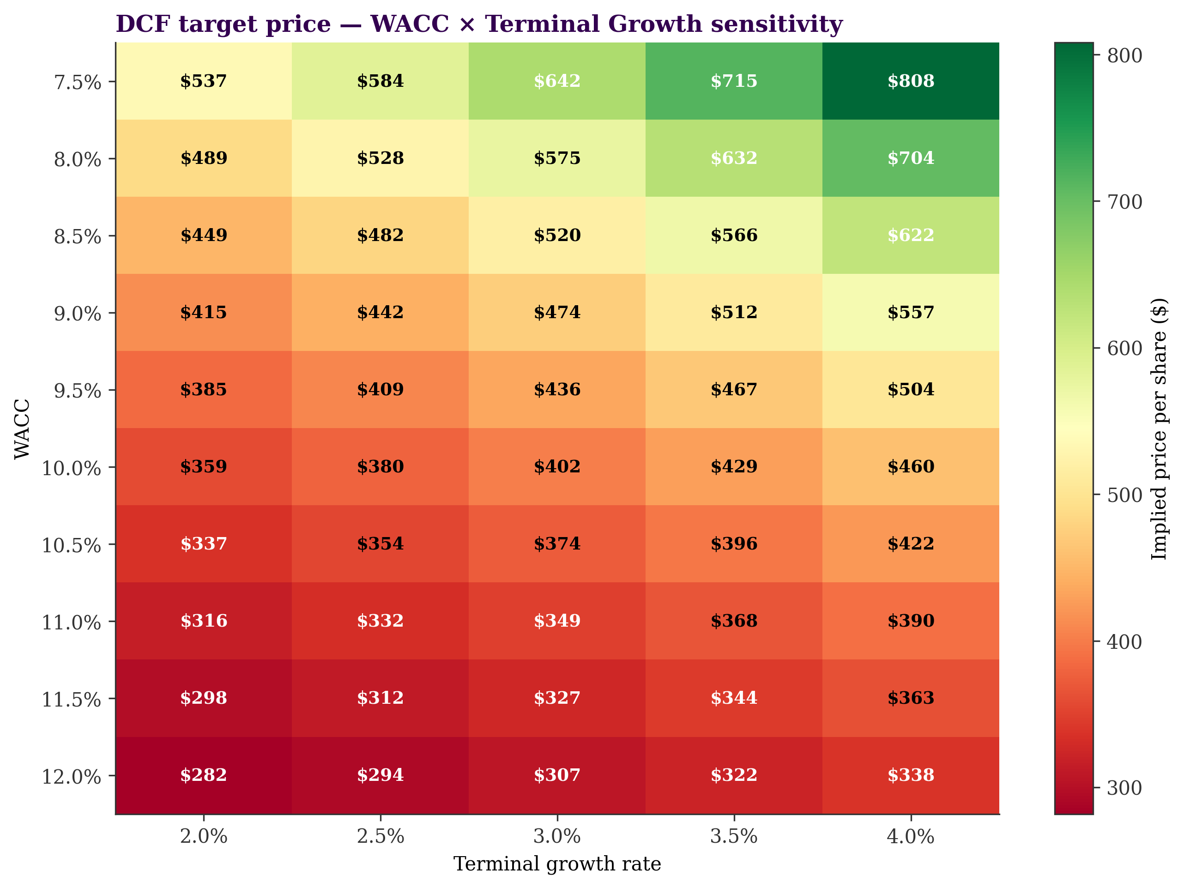
DCF
WACC Build (9.50%)
R_{f} : 4.31% (10Y T-Note)
ERP: 5.0%
Beta: 1.20 (2Y weekly)
Cost of Debt: 5.0% (pre-tax)
Terminal Growth: 3.0%
Result
Base Case: $436 per share.
Sensitivity: $402–$474 range at ±50bps WACC.
Caveat: Terminal value is 80% of EV.
7

Slide 9
SOTP & Comps
Sum-of-the-Parts (Mid: $401)
Segment | Mult | Val ($)
Semi (EBITDA 62%) | 20x | $321
Software (EBITDA 77%) | 17x | $482
Implied Price |  | $ 401
Trading Comps (Fwd P/E Mid: $414)
Multiple | Ratio | Val ($)
Fwd P/E (on $18.83) | 22x | $414
Implied Price |  | $ 414
Separates hardware (NVIDIA/AMD comps) from mature SaaS
Peer median Fwd P/E is 28.3x; we apply a conservative 22x.
Peer median EV/EBITDA skewed by AMD/MRVL (31.8x).
Both relative methods cluster between $400 and $440, supporting the DCF base case.
8

Slide 10
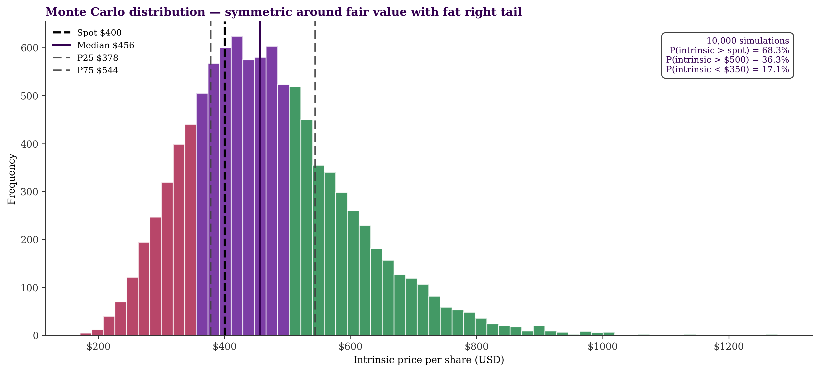
Monte Carlo
10,000 Paths with 6 Inputs
FY27 AI Rev: Normal($125B, $25B) - Anchors on Street median.
Terminal g: Normal(3.0%, 0.5%)
WACC: Normal(9.5%, 0.5%)
Result
Mean: $471
P25 / P75: $378 / $544
Probability > Spot: 68.3%
9

Slide 11
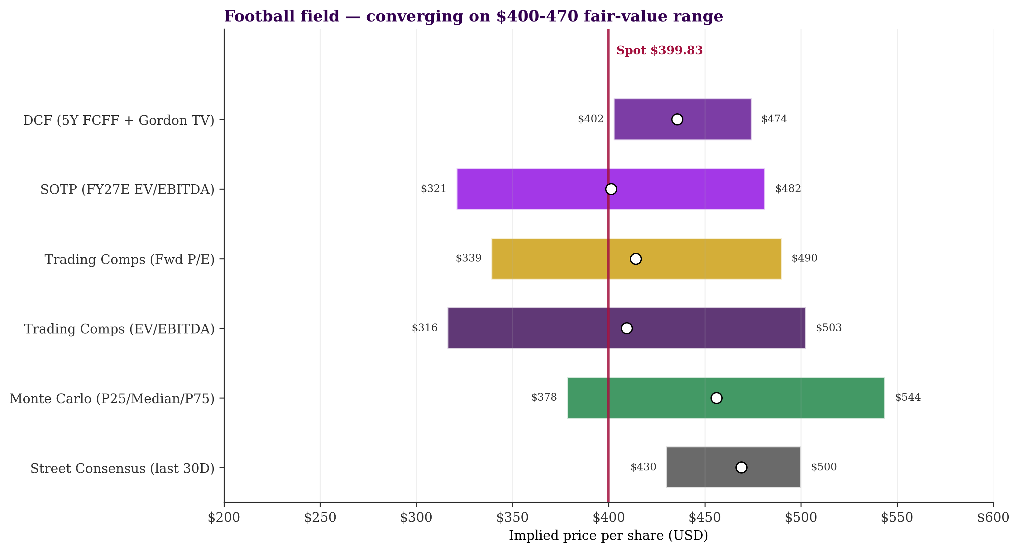
Football Field Synthesis
Ranges: - DCF: $402–474 - SOTP: $321–482 - Comps Fwd P/E: $339–490.
Convergence: Six methods cluster in the $400–$510 range.
Conclusion: $475 PT anchors on the Monte Carlo mean ($471) plus right-tail premium.
10

Slide 12
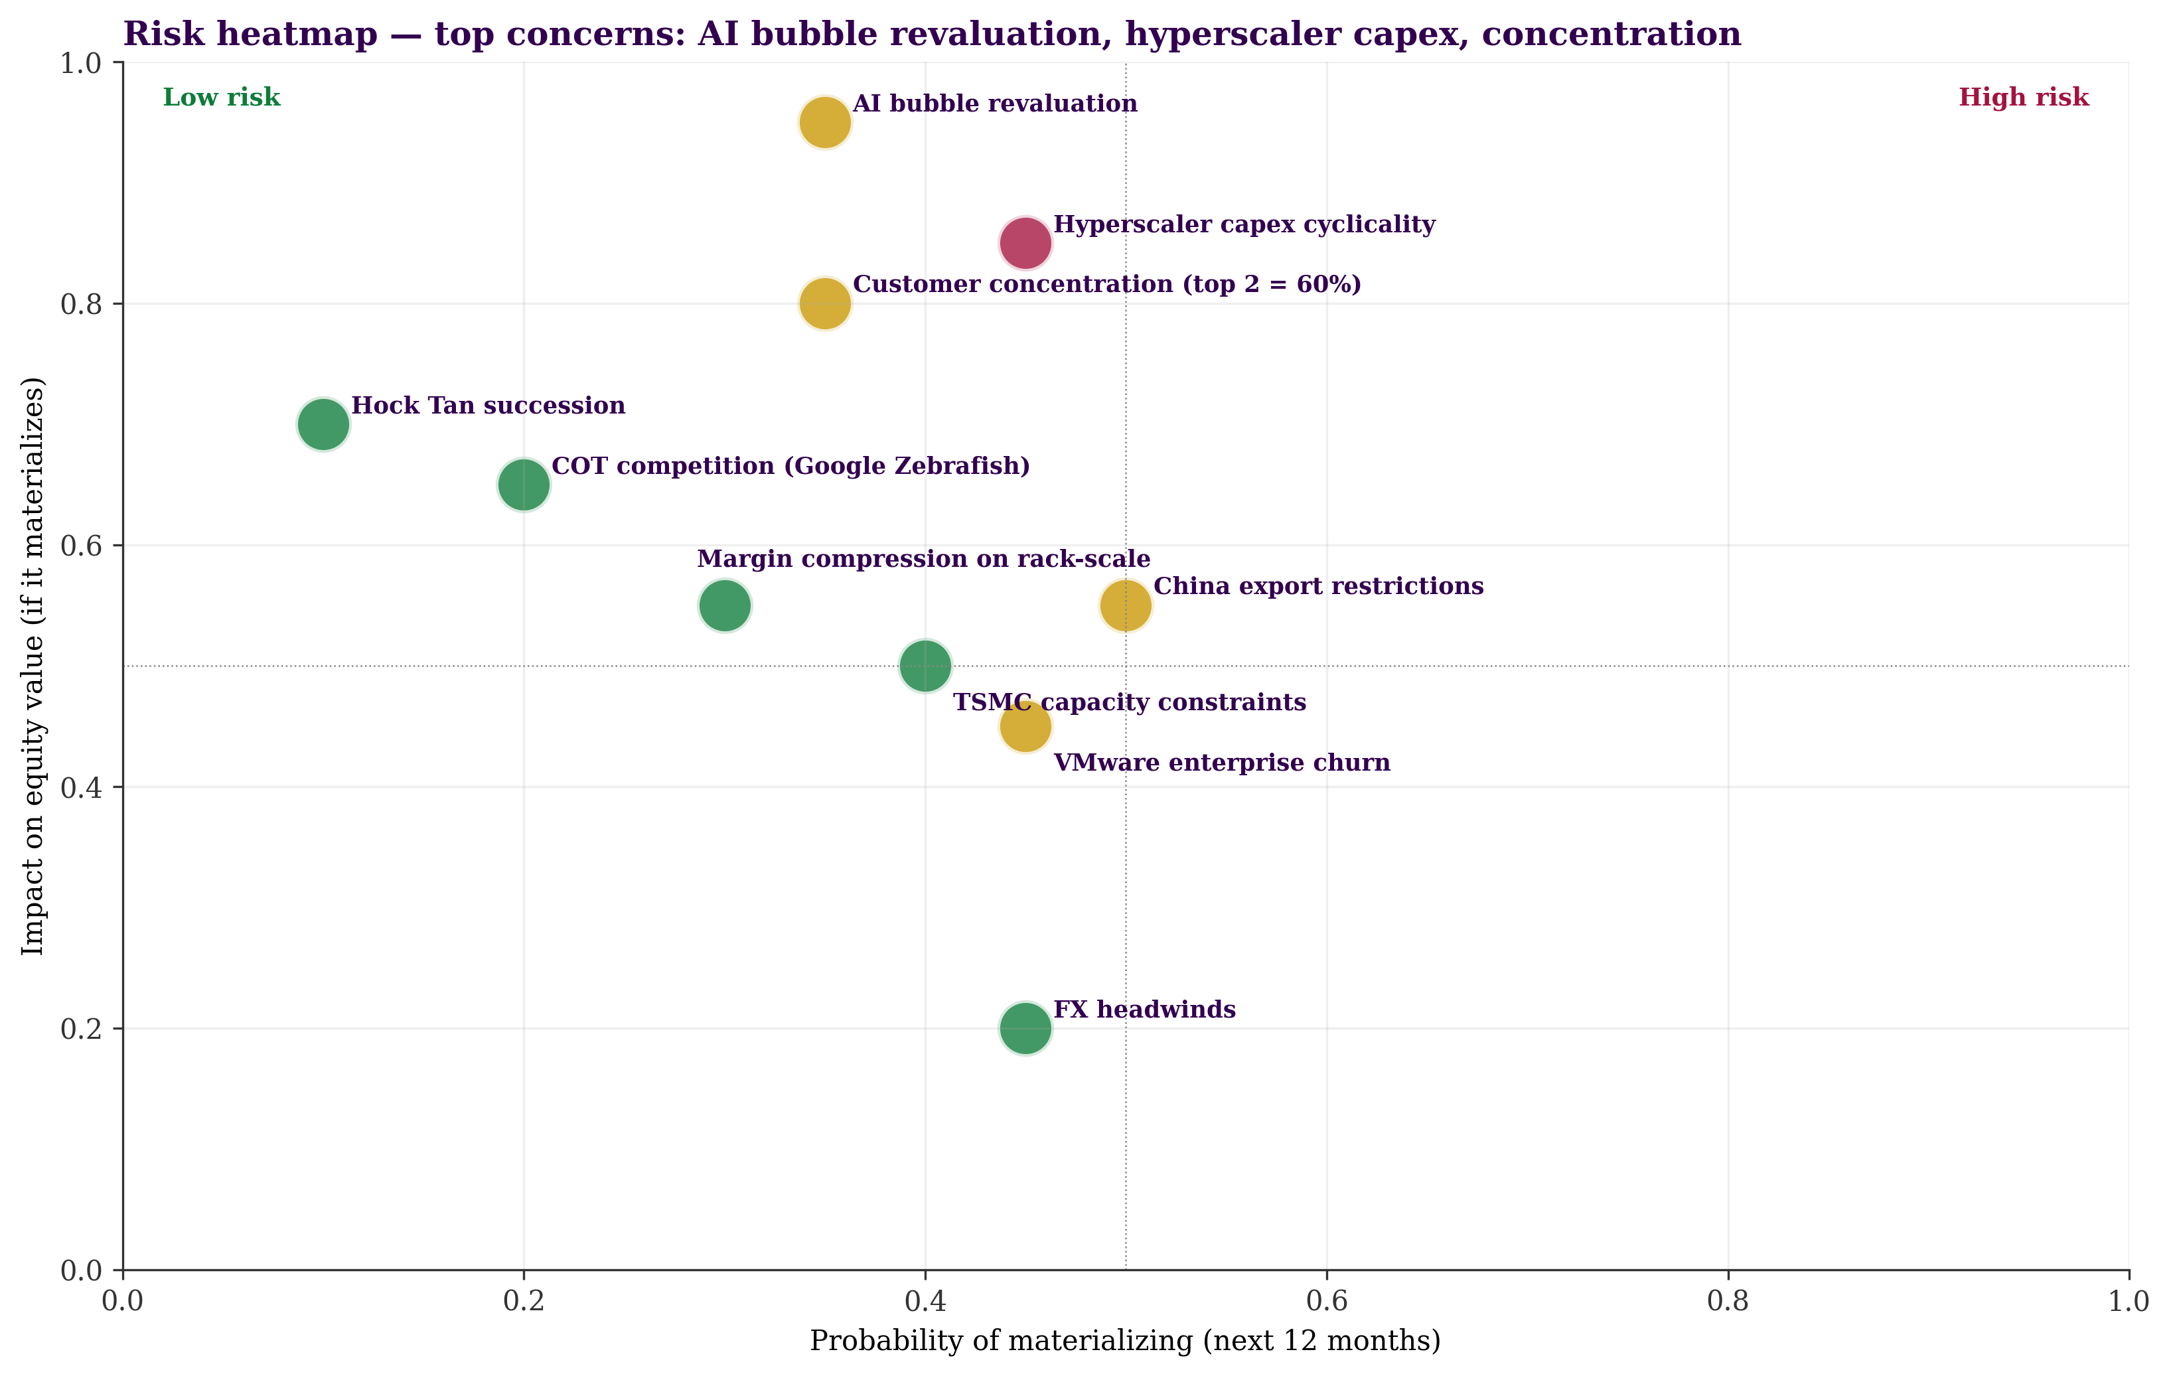
Risk Framework
Top-Right Risks (High Prob/Impact)
Hyperscaler Capex: Coordinated Google/Meta/MSFT pullback compresses multiple and revenue (30% downside modeled).
Customer Concentration: Google + Anthropic ∼60% of FY27 AI mix.Beta: 1.20 (2Y weekly)
AI Bubble Revaluation: AVGO highly exposed to multiple compression given 80% terminal value share.
11

Slide 13
Catalyst Calendar & What would change our view?
Date | Catalyst Event
5-Jun-2026 | Q2 earnings — AI revenue actuals vs. $10.7B guide.
H2-2026 | TPU Sunfish 3nm volume ramp + OpenAI rack deployments.
4-Sep-2026 | Q3 earnings — First framing commentary on FY27.
Dec-2026 | Q4 + FY27 Guide — Critical print to validate $100B+ AI floor.
What would move us off BUY:
Spot breaks $475 | FY27 AI guide < $100B | Google share-loss to Zebrafish
12

Slide 14
Recommendation Summary
Broadcom Inc. (AVGO)
BUY | $475 PT | +19%
68.3% probability of upside vs. $399.83 spot
Top Catalyst: Dec-2026 FY27 Guide | Top Risk: Hyperscaler Capex
Q&A
Tanishk Yadav | Martin Barreto | Ramana Sriram
13

